Slide 1



Computer Engineering
Lucas Weaver

Slide 2
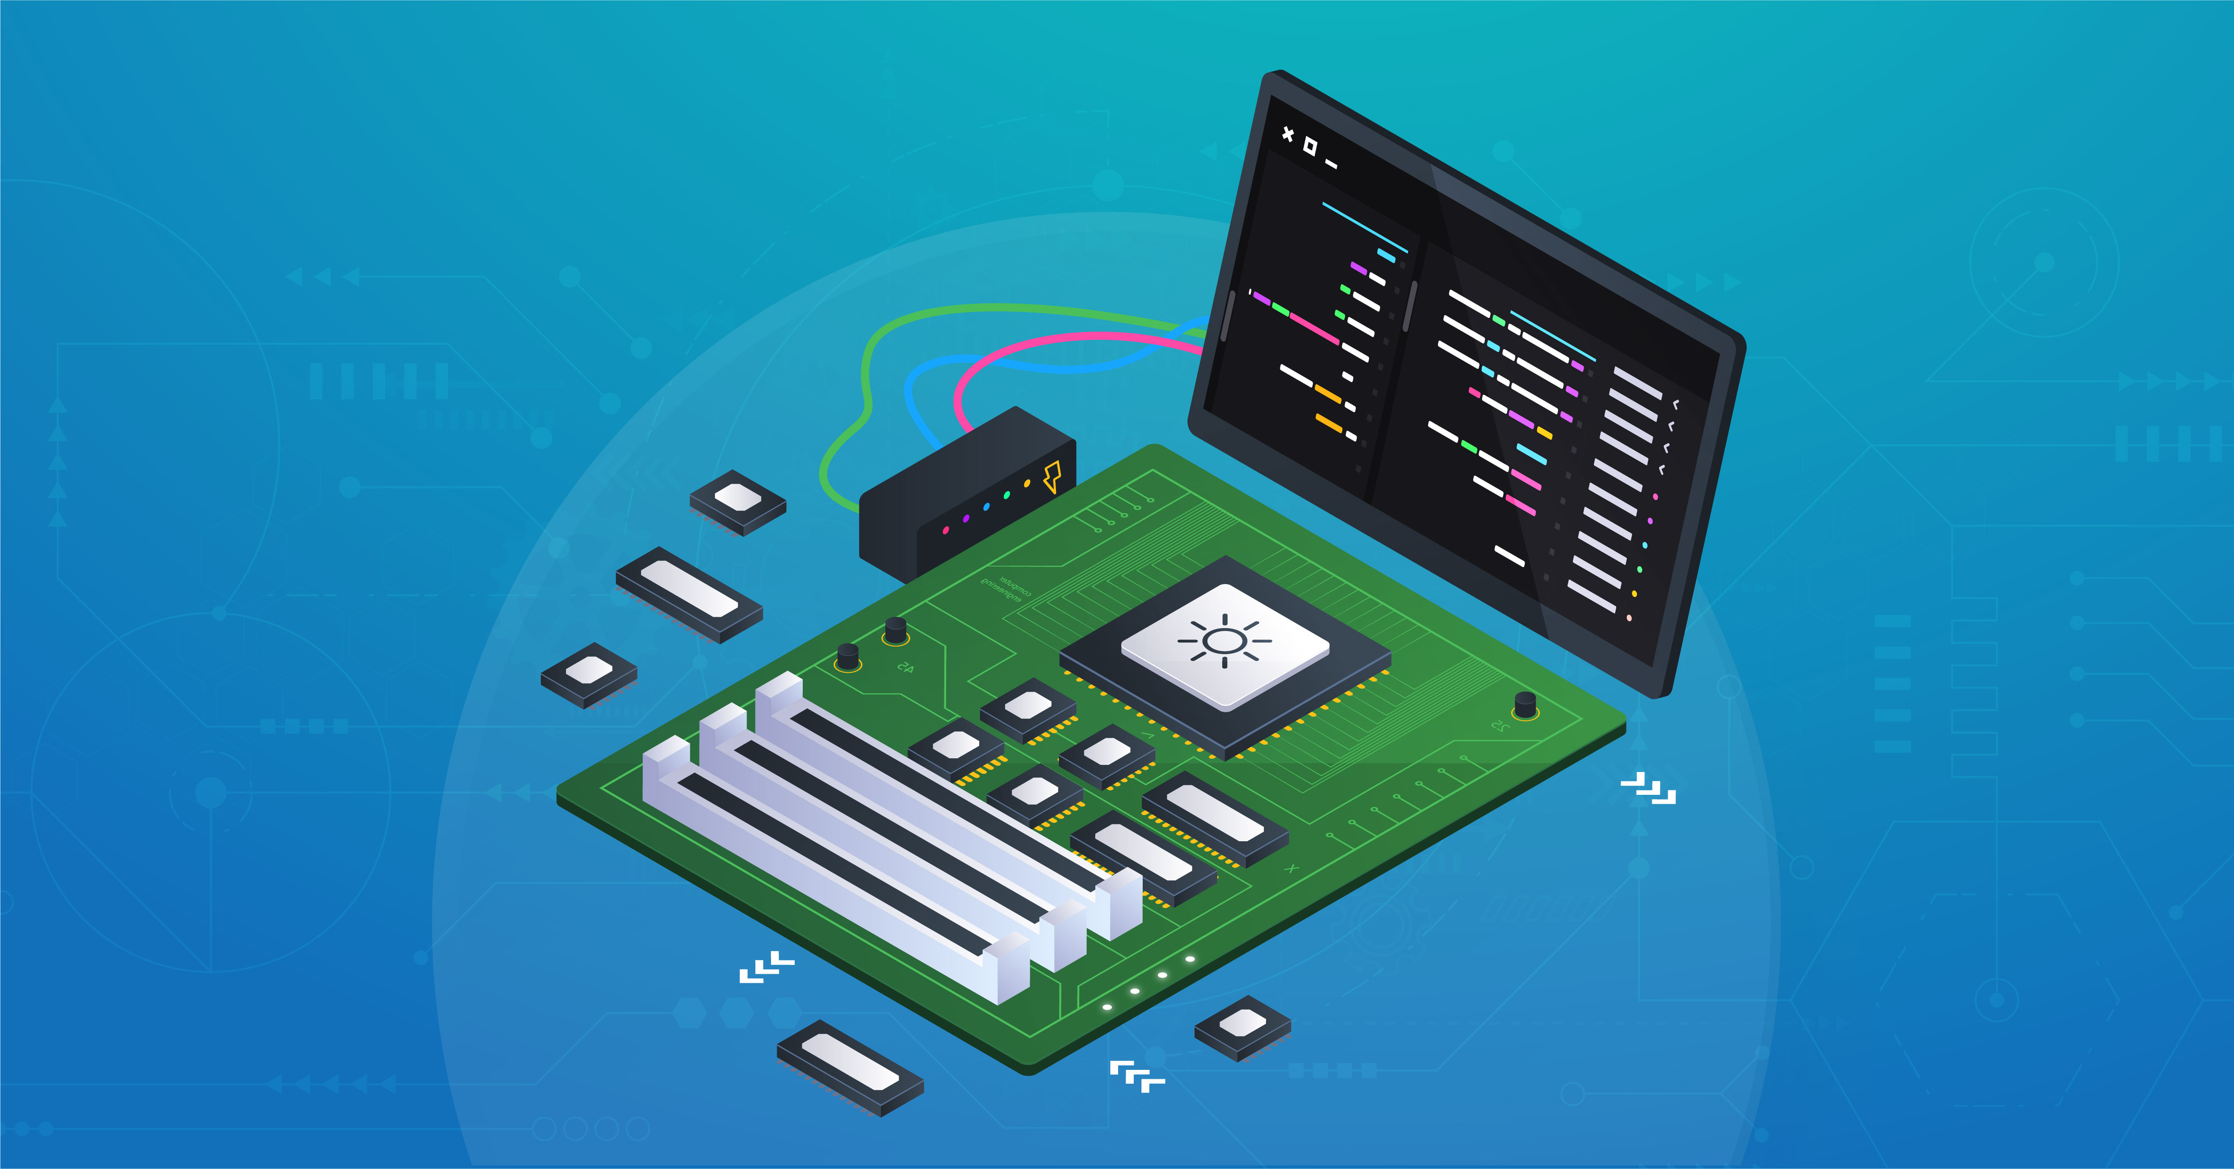
What is Computer Engineering
Computer engineers do not focus on hardware or software exclusively but are the bridge between software and hardware
Usually work with hardware and low level software.

Slide 3


Fields of interest in computer engineering
Computer hardware
Network engineering
Software engineering
Embedded Systems
IoT devices

Slide 4
Computer Engineering Degree

Slide 5
Computer engineering clubs at uf

